Slide 1
SuperUsers HR System
Ortagus Winfrey
Mechal Terfie
Shenila Daredia
Dalya Khatun
Ryan Ocampo

Slide 2
Problem Statement
We aim to develop a flexible Human Resource Management System specifically for medium-sized Grocery store corporations. This system will utilize SQL for database inquiries. Using the Browser the HR department would log into the system. From there they would be able to search for employees using their worker ID key from the table. Once the worker is pulled up using the system, the worker’s full information will also be displayed for the HR department.
Using these specifications, a company would be able to create departments as tables, and would allow employees to be placed into departments. A considerable business restraint would be that the system will have to be accessed via a web browser interface.
Notes:
Business constraint- physical and software requirements for application to work

Slide 3
“Employees can supervise other Employees, Employees work for Positions, Positions are found under Departments, Salary offered by Positions, and Departments are located within Stores.”

Slide 4
Roles
Ortagus Winfrey- Analyst
Ryan Ocampo- Architecture/back-end
Mechal Terfie- Backend/testing
Shenila Daredia- Frontend/back-end
Dalya Khatun- Frontend/back-end/testing
Notes:
Ortagus Winfrey-Analyst
Ryan OCampo-Architecture/backend
Mychal Terfie-Backend/testing
Shenila Daredia-Frontend/mysql development
Dalya Khatun-Frontend/backend; testing

Slide 5
Entities

Slide 6
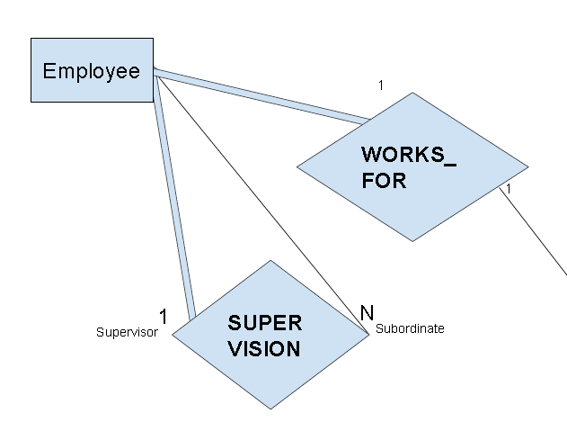
<Employee>
Workers that make up the company
Has a 1:1 relation with our <Position> entity
“Every employee works one position, but every position may not be filled by an employee.”
Partial Participation
Notes:
Ortagus;

Slide 7
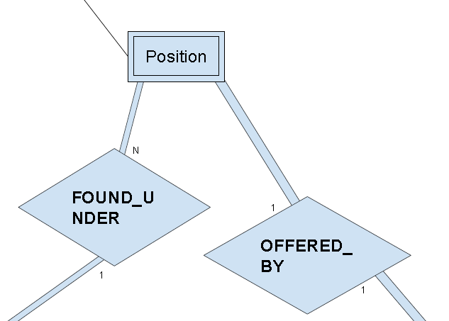
<Position>
Identifying role within the company
Has an N:1 relation with our <Department> entity
“Individual departments can have many positions”
Full Participation
Notes:
Shenila- *full participation because each position must be inside at least one department

Slide 8
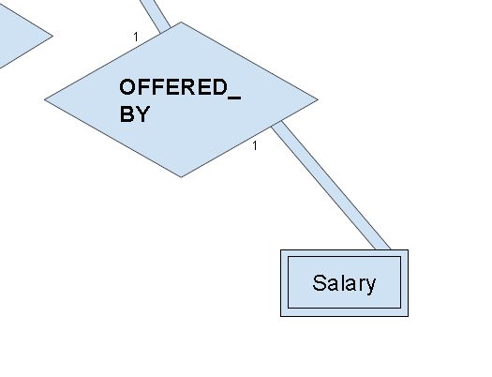
<Salary>
Initial income provided by work position
Has a 1:1 relation with our <Position> entity
“Positions will be mapped to a base salary until it is deemed negotiable or non-negotiable by human resources”
Full Participation
Notes:
Ryan- *full participation, because each salary must be associated with a position

Slide 9
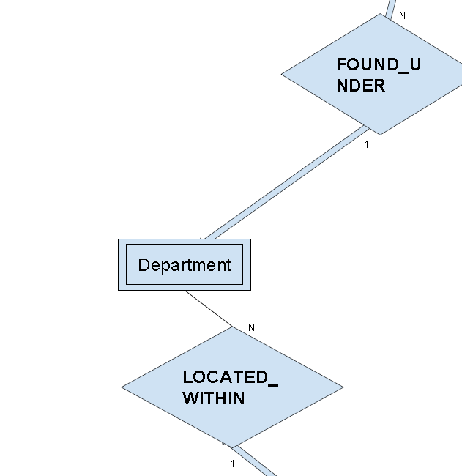
<Departments>
Specified divisions that focus on different production aspects of a company
Has an N:1 relation with our <Store> entity
“Various amounts of departments can be considered for each store.”
Partial Participation
Notes:
Mechal- *Partial participation, because one store can have different or more departments in comparison to another

Slide 10
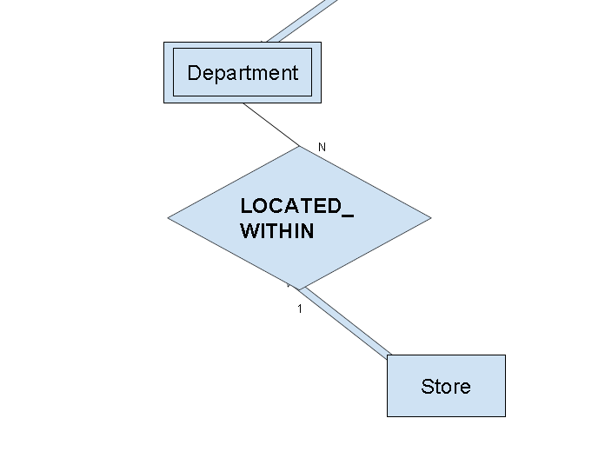
<Store>
The location where each employee,position, and department are located.
Has a 1:M relation with our <Department> entity
“Individual stores can have many departments and many departments can be located within a store”
Total Participation
Notes:
Dalya- *Full participation, because each store must have 2 or more departments

Slide 11
ER Diagram

Slide 12
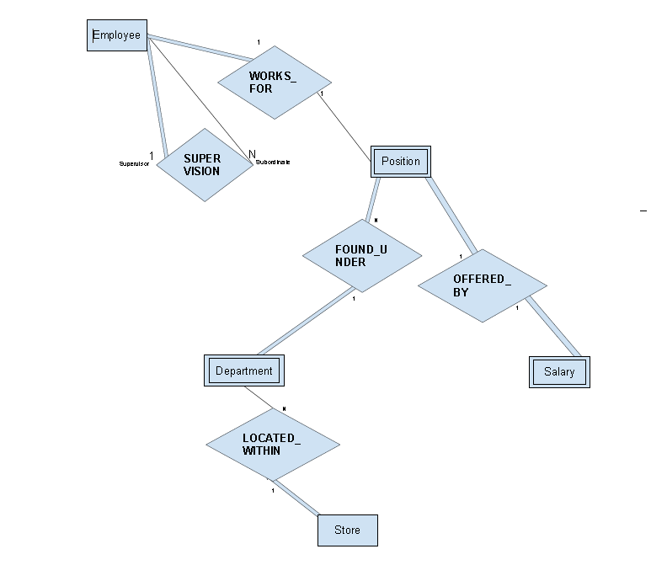

Slide 13
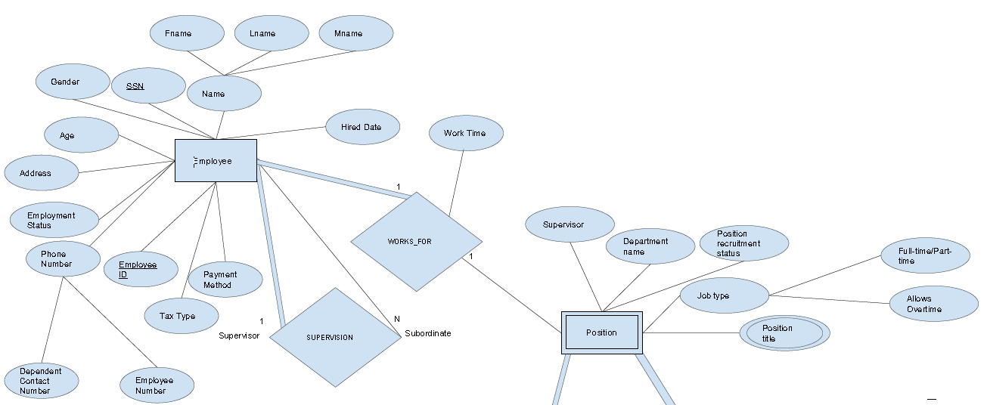
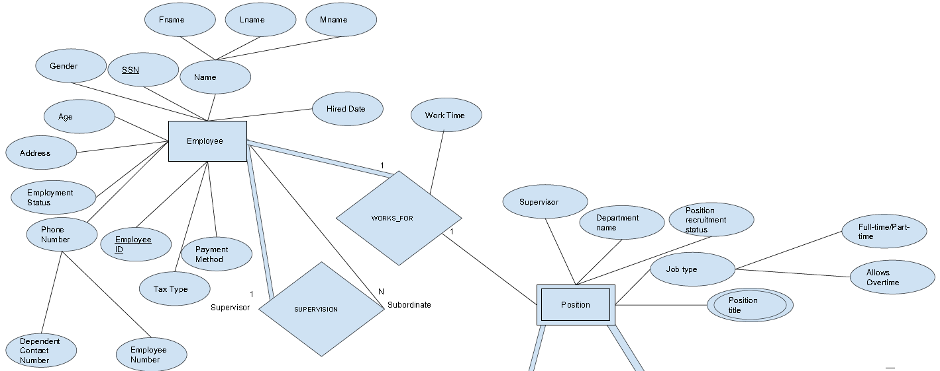

Slide 14
